Slide 1

Hostel management system
SUPERVISOR : B.S.S.MONICA MAM
EPICS PROJECT
BATCH 28
421217
421262

Slide 2
INTRODUCTION
Hostel Management system is a web application developed for managing the various operations of hostel, including
Room Registration
Student Details
Local and Non-local outings Details
Employee Details
billing and payments.
The main objective of this mini project is to develop a simple and user-friendly hostel management system that can help hostel administrators manage their daily tasks more efficiently

Slide 3
ABSTRACT
The Hostel Management System is a web application designed to manage the management of hostels. The system is developed to manage the room allocation, billing and payments, inventory management, Local and Non-local outings, and security of the hostel.
The hostel management system allows students to reserve rooms online, receive confirmation and check-in details by email or text message. The system also provides easy access to important information such as hostel rules and regulations, emergency contacts and takes student feedback which help to identify areas of improvement and make data-driven decisions
The system allows to admin to access the student details as well as employee details can check all the data in the system and it automates many manual tasks and reduces the the workload of administrative staff, increasing efficiency and accuracy.
Overall, the hostel management system is designed to improve the student experience, increase efficiency, and enhance the security of the hostel.

Slide 4
ADVANTAGES
The main advantages of this system are
Reduces the time as well as man power
Easy data availability
Easy data accessibility
Easy data maintainance
Good security for user information

Slide 5
TECHNOLOGIES USED
FRONT-END
HTML
CSS
JAVA SCRIPT
BACK-END
PHP
MYSQL

Slide 6
HTML,CSS and JAVA SCRIPT are used for the development of Front End ​
HTML :- HTML is the Language used for describing the structure of the web pages
CSS :- CSS is used to style and Layout the web pages
JAVA SCRIPT :- Java Script is commonly used for web pages.It allows us to add Dynamic behaviour to the web pages​
FRONT-END

Slide 7
PHP :- It is used for server connection​
MYSQL :- It is used for Database connection​
BACK-END

Slide 8
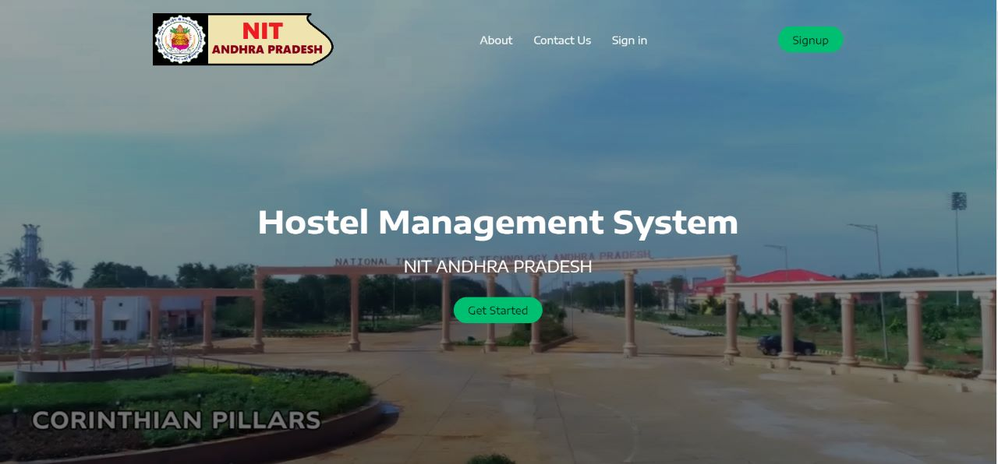
PROJECT DEMO
HOME PAGE

Slide 9
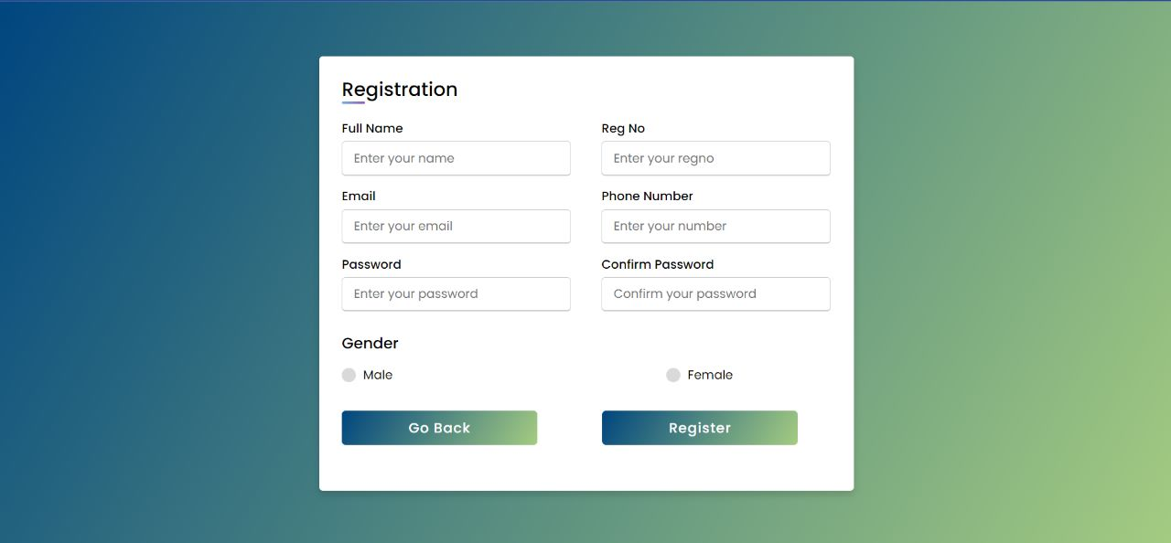
For New student Registration

Slide 10
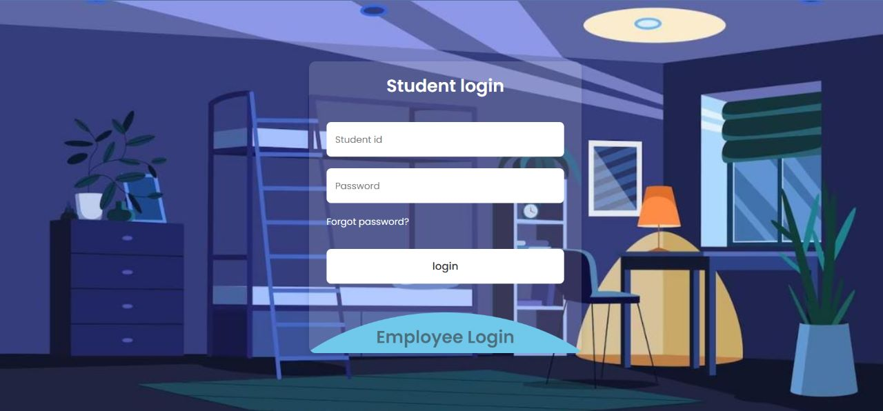
For student log in

Slide 11
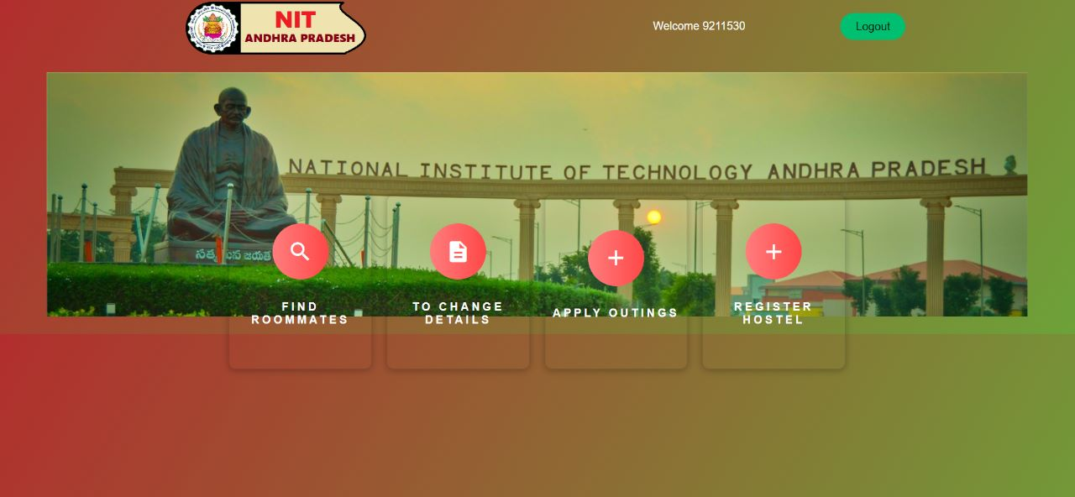
After student log in it moves to student dashboard

Slide 12
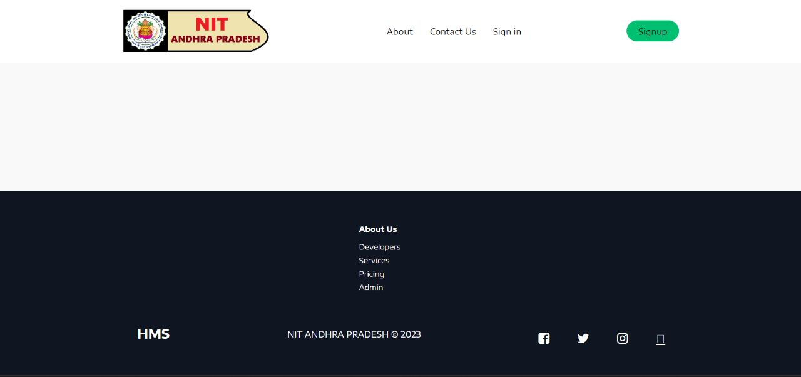

Slide 13
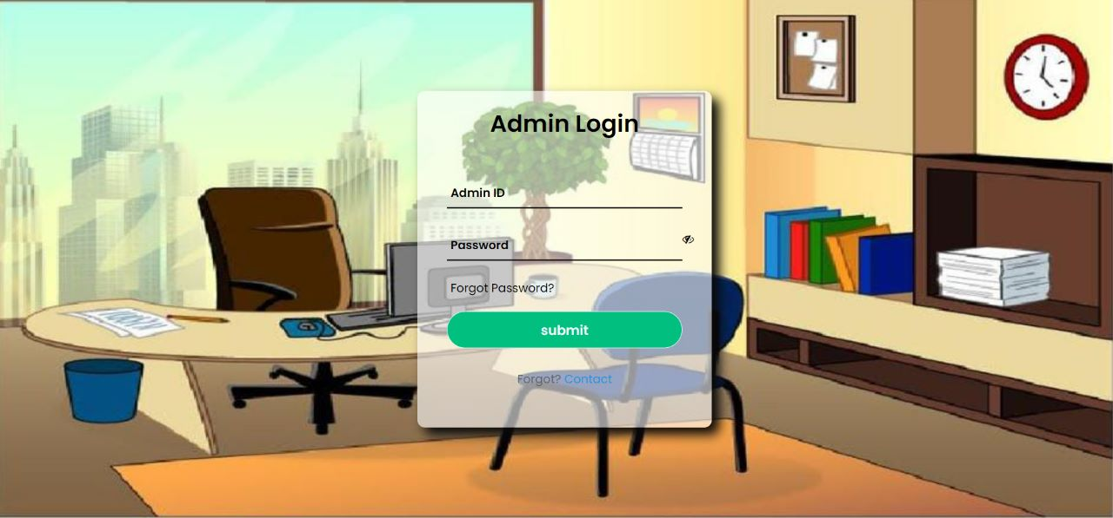
Admin login page

Slide 14
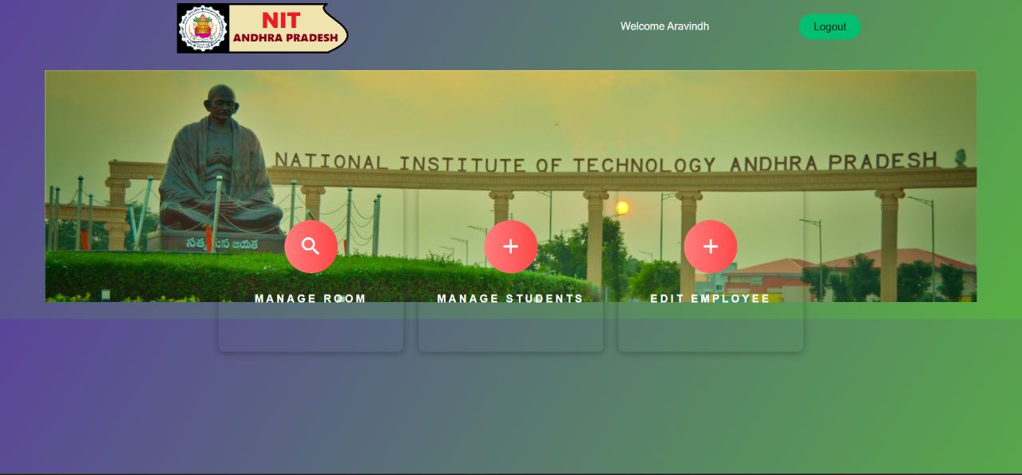
After admin login it moves to admin dashboard

Slide 15
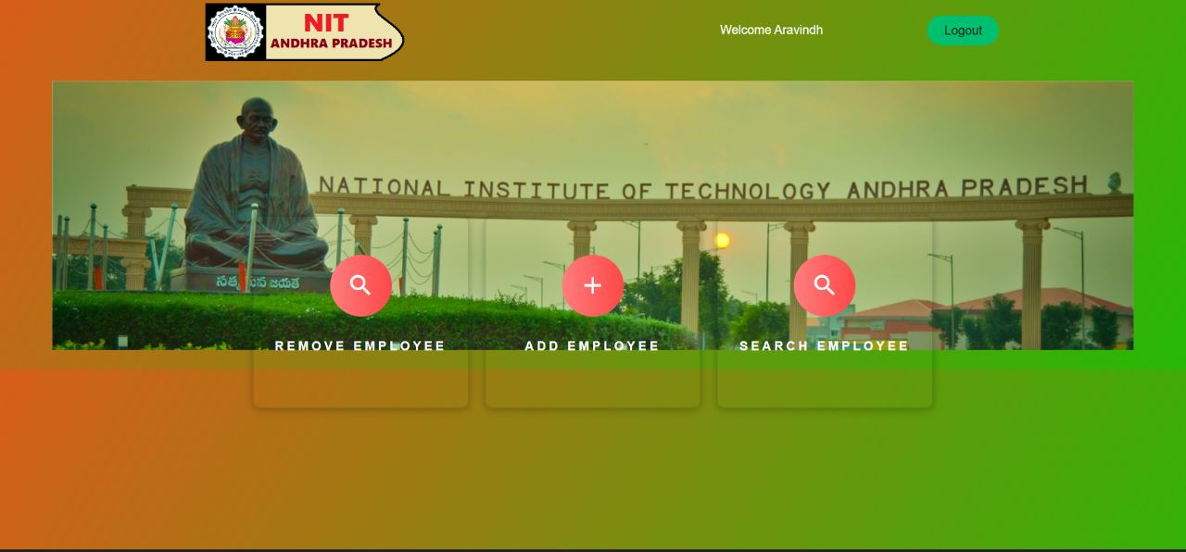
Admin can edit or remove employee

Slide 16
THANK
YOU

